Slide 1
QA (QUESTION ANSWERING)
ONLY ONCE:
  24 June, 2024, Monday, 18th week
  15:00 - 17:00
  Tencent Meeting (腾讯会议)

Slide 2
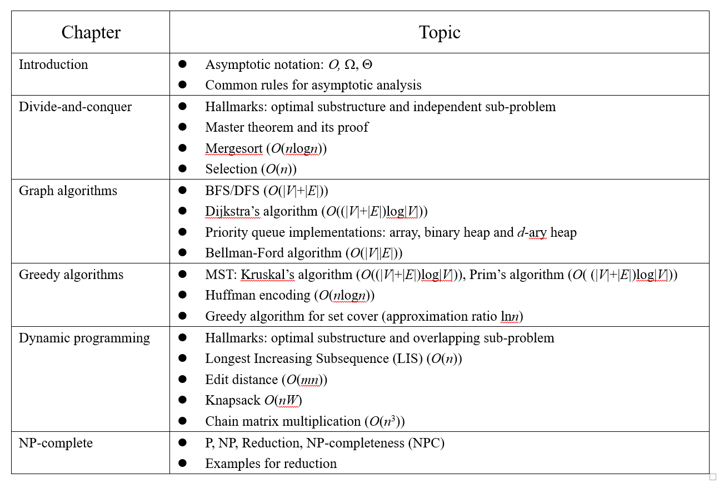

Slide 3
QUESTION TYPES OF FINAL EXAM (MAYBE)
Choice (15 Points, 5 problems)
True/False (15 Points, 5 problems)
Short Questions (20 Points, 4 problems)
  Asymptotic analysis, Master theorem, Priority queue implementations, NPC, …
Design and Analysis (50 Points, , 4 problems)
  D&C, DP, Greedy algorithms, Graph algorithms, …
How to review?
  PPT + exercise

